Slide 1
Database Management
By
Shakleen Ishfar
Student ID: 160041029
Department: CSE

Slide 2
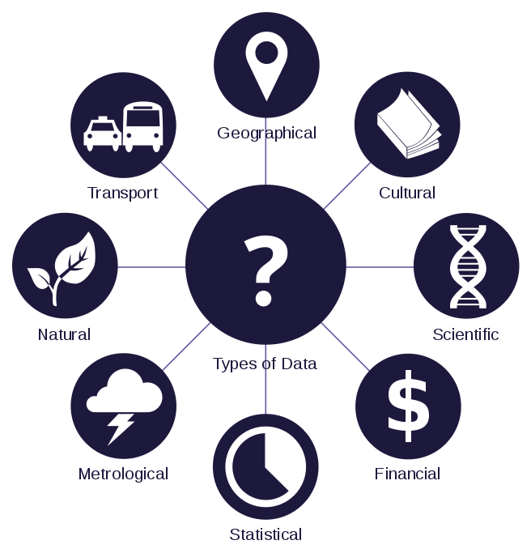
Data and Information
Data
Raw, unorganized facts needing to be processed.
Something simple and seemingly random and useless until it is organized.
Information
Data processed, organized, structured or presented in a given context so as to make it useful.

Slide 3
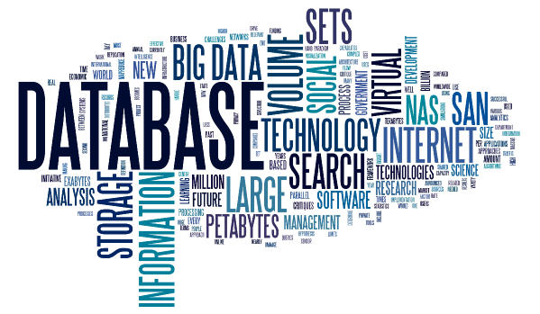
Database
Organized collection of data
Contains schemas, tables, queries, reports, views, and other elements
Accessible in various ways

Slide 4
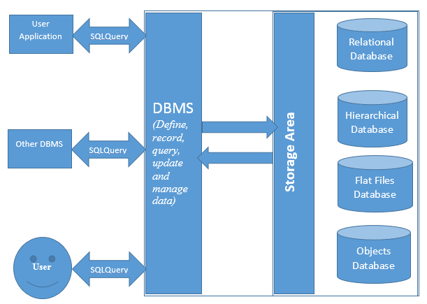
Database Management System (DBMS)
Is a computer application
Interacts with users, other applications and the database itself to capture and analyze data
Allows the definition, creation, querying, update and administration of databases.
Examples: Oracle, Microsoft SQL server etc.

Slide 5
Application of DBMS
Reservation System
Management
Economy
Connectivity
Military

Slide 6
Reservation System
Hotel
Rooms
Restaurant
Tables
Travel
Airway
Entertainment
Movie
Train
Bus
Ship
Rooms
Entire restaurant
Stadium
Concert
Condos
Suites

Slide 7
Management
Library
Books
Education
Exams
Enterprise
Users
Usage
Routines
Results
Storage
Manufacturing
Students
Human Resource
Delivery

Slide 8
Economy
Economy
Banking
Ecommerce
Stock Exchange
Banking
Account
Transaction
Ecommerce
Customer
Product
Stock Exchange
Company
Company stock
Business
Value change

Slide 9
Connectivity
Social Media
Telecommunication
Connections
Uploads
Preferences
Usage
Billing
User

Slide 10
Military
Soldiers
Resources
Operations
Defense
Intelligence
Development

Slide 11


